Slide 1

Work Order Data Visualization using PowerBI

Slide 2
Our Team
ROCHAN MEHTA
SARATHCHANDRAN SANTHOSH
KARTHI KUTHALINGAM
GROUP: C
BDM 1043 BIG DATA FUNDAMENTALS
AMRITA GYAWALI
NAVNEET KAUR
Notes:
<a href="https://storyset.com/business">Business illustrations by Storyset</a>

Slide 3




Introduction to Input Data Set
Work Order is the task assigned to a particular person or a group of members. It enables you to keep track of tasks, and update requesters on your progress so they are aware of the value you provide. These requests may come from employees, clients, residents, or even directly from your technicians, depending on the kind of business and facilities being managed.
It may include details like:
Worker details to whom task is assigned.
Labor estimates.
Time period.
Location and type of the work Order
Notes:
<a href="https://storyset.com/business">Business illustrations by Storyset</a>

Slide 4
Input Data Set
Our Data is related to work orders received by an Electronics company dealing mainly in air conditioners.
It consists of 7 Tables:
WorkOrders : Main Table that is updated each time a new work order is received.
PaymentType : Has list of different payment methods.
District: It contains the list of district name and their corresponding district id.
Province: It contains the list of province name and their corresponding province id.
Technician: It contains the list of technician name and their corresponding technician id.
Service: It contains the list of service name and their corresponding service id.
TechRate: It contains different rate brackets.
WorkOrder Table is the main table that records any new orders. In our data set we have approximately 1000 records depicting workorders of 1 year starting from 1st September 2020.
Notes:
<a href="https://storyset.com/people">People illustrations by Storyset</a>
<a href="https://storyset.com/people">People illustrations by Storyset</a>

Slide 5

Understanding Our Data set and their schema

Slide 6
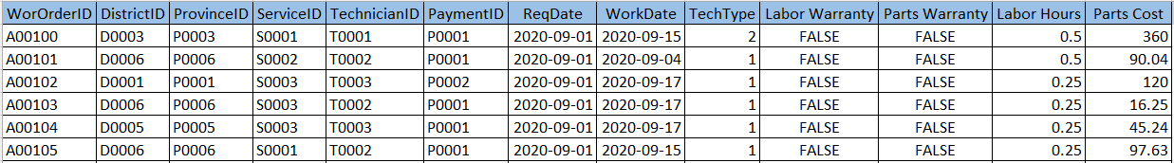
WorkOrders
WorkOrderID: Unique work order ID.
DistrictId , ProvinceId: Geographic area of work location.
ServiceId: ID for different types of services(Assess, Deliver, Install, Repair, Replace)
TechnicianId: ID for the technicians who are working.
PaymentId: ID for different types of payment made(Account, C.O.D, Credit, P.O, Warranty).
ReqDate: Date when the request is recorded.
WorkDate: Date when the task has been completed.
TechType: Number of technicians required based which the order will be charged on
different Rate brackets.
Labor Warranty: Does the labor is under warranty?
Parts Warranty: Does the parts are under warranty?
Labor Hours: Number of labor hours.
Parts Cost: Cost of the parts.

Slide 7
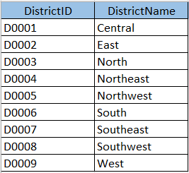
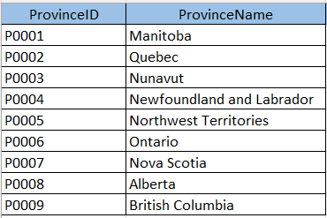
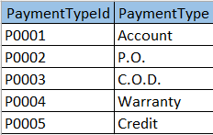
PaymentType, District and Province
PaymentTypeId : Unique id for respective Payment Type.
PaymenType : different Payment Methods.
DistrictId : Unique id for respective Districts.
PaymenType : Different district names.
ProvinceId : Unique id for respective Provinces.
ProviceName: Different province names.

Slide 8
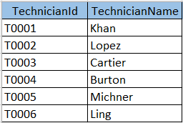
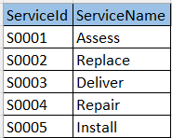
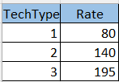
PaymentType, District and Province
TechnicianId : Unique id for respective Technicians.
TechnicianName: Name of the Technicians working in the organization.
ServiceId: Unique id for respective Services.
Service Name : Different services the organization provides.
TechType : Number of technicians required based which the order will be charged on different Rate brackets.
Rate: Different rates for different brackets.

Slide 9




Our Approach
1
Data Cleaning
2
Data Storage
Data set had a lot of null values and information that could have made more sense if populated properly. Hence cleaning of the data was a necessity.
The data was loaded into mysql and then stored as external tables in HDFS using Sqoop and hive.
3
Data Processing
4
Data Visualization
Based on the available data, a master view was created containing many of the merged columns and some of the calculated columns that were discussed earlier.
Power BI was used to establish connection with hive and import the data to create reports that can provide import insights and further analysis can be done based on the reports to improve the productivity of the organization.
Notes:
<a href="https://storyset.com/education">Education illustrations by Storyset</a>
https://unsplash.com/photos/b6njEJXi9zE

Slide 10
Tools used for data processing and visualization:
Microsoft Excel For Data Cleaning.
Hadoop For Data storage.
Hive and Sqoop For Data Processing.
PowerBI For Data Visualization.

Slide 11
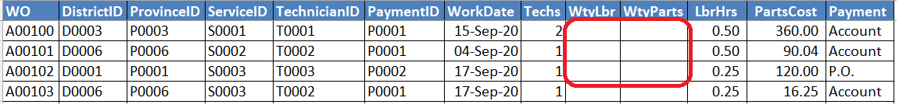
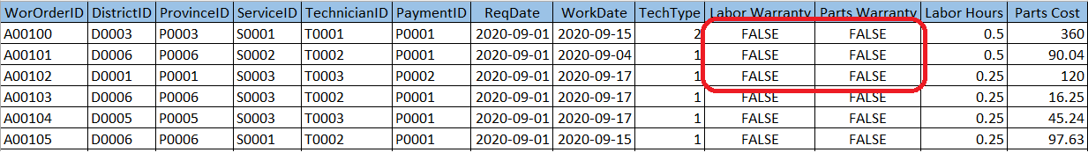
Data Cleaning
Null values had to be managed.
Incomplete data had to be completed with default values.
Had to fix structural errors.
Had to remove duplicates.

Slide 12
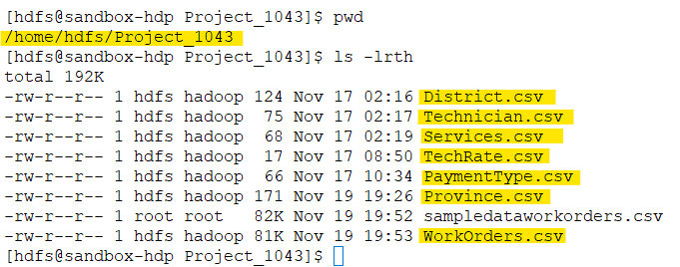
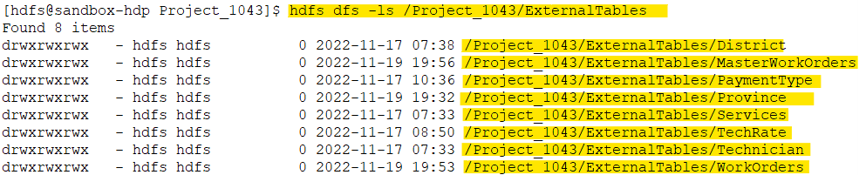
Data Storage
Local Server
Hadoop File System
All the cleaned csv files were uploaded to local server.
A directory structure was created on the hadoop file system.
All the csv files were uploaded to HDFS in their respective directories.
Proper permissions were given to both the files and the directory structure.

Slide 13
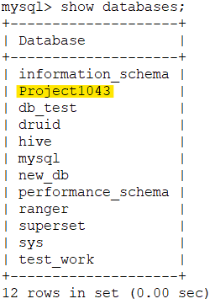
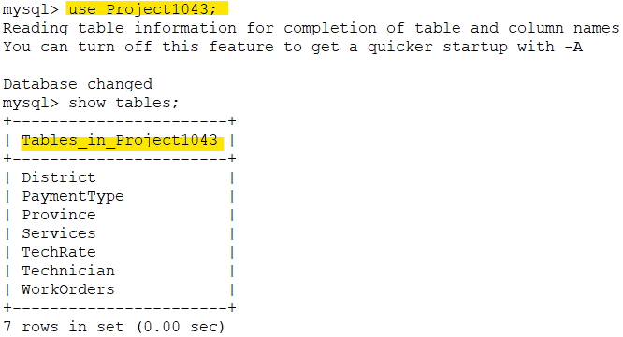
Data Processing
As per the data, tables with proper required schema were created in mysql.
Data was loaded into the respective mysql tables using load commands. Below is a sample of both commands
LOAD DATA LOCAL INFILE '/home/hdfs/Project_1043/District.csv'
INTO TABLE District
FIELDS TERMINATED BY ','
LINES TERMINATED BY '\n';
create table District(DistrictID varchar(255),
DistrictName varchar(255));

Slide 14
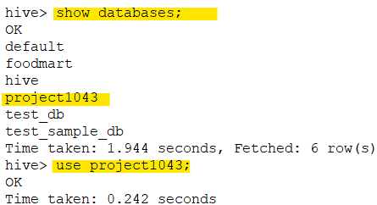
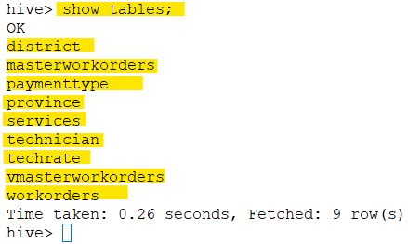
Data Processing (Continued..) : Approach 1
As per the data, External Tables with proper required schema were created in hive.
Data was loaded into the hive tables from mysql using Sqoop import commands. Below is a sample of both commands
create external table Province(ProvinceID string, ProvinceName string)
row format delimited
fields terminated by ','
stored as textfile
location '/Project_1043/ExternalTables/Province';
sqoop-import --connect jdbc:mysql://sandbox-hdp.hortonworks.com/Project1043
--username root --P --table Province --hive-import --hive-table Province
--hive-database Project1043 -m 1 --fields-terminated-by ',’;

Slide 15
Data Processing (Continued..) : Approach 2
As per the tables in mysql, Managed Tables were created in hive using sqoop import commands.
After the tables were created, they were altered to be External Tables. Below is a sample of both commands
sqoop-import --connect jdbc:mysql://sandbox-hdp.hortonworks.com/Project1043
--username root --P --table Province --hive-import --create-hive-table
--hive-table Province --hive-database Project1043 -m 1 --fields-terminated-by ','
Alter table Province SET TBLPROPERTIES('EXTERNAL'='TRUE')

Slide 16
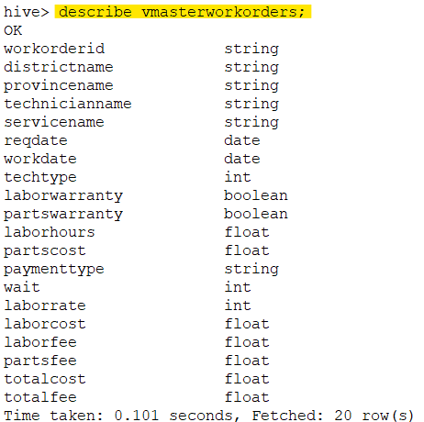
Data Processing (Continued..)
create view vMasterWorkOrders as
with result as (
select w.workorderid as workorderid, d.districtname as districtname,
pr.provincename as provincename, t.technicianname as technicianname,
s.servicename as servicename, w.ReqDate as ReqDate,
w.workdate as workdate, w.techtype as techtype,
w.LaborWarranty as LaborWarranty, w.partswarranty as partswarranty,
w.laborhours as laborhours, w.partscost as partscost,
p.paymenttype as paymenttype,
datediff(w.workdate,w.ReqDate) as wait,
tr.Rate as LaborRate,
(tr.Rate*w.laborhours) as LaborCost,
if(w.LaborWarranty=true,0,tr.Rate*w.laborhours) as LaborFee,
if(w.partswarranty=true,0,w.partscost) as PartsFee
from workorders w
join district d on w.districtid = d.districtid
join province pr on w.provinceid = pr.provinceid
join technician t on w.technicianid = t.technicianid
join services s on w.serviceid = s.serviceid
join paymenttype p on w.paymenttypeid = p.paymenttypeid
join techrate tr on w.techtype = tr.techtype)
select result.*, (result.partscost+result.LaborCost) as TotalCost,
(result.LaborFee+result.PartsFee) as TotalFee
from result
join workorders wo on wo.workorderid = result.workorderid;
We created a master view using the existing tables in hive.
This Master view consisted of 13 normal and 7 calculated or computed columns.
Each column representation will be explained further.

Slide 17
13 Normal Columns:
WorkerID: From WorkOrders Table.
DistrictName: From District Table.
ProvinceName: From Province Table.
TechnicianName: From Technician Table.
ServiceName: From Service Table.
ReqDate: From WorkOrders Table.
WorkDate: From WorkOrders Table.
TechType: From TechRate Table.
LaborWarranty: From WorkOrders Table.
PartsWarranty: From WorkOrders Table.
LaborHours: From WorkOrders Table.
PartsCost: From WorkOrders Table.
PaymentType: From PaymentType Table.
Notes:
<a href="https://storyset.com/people">People illustrations by Storyset</a>
<a href="https://storyset.com/people">People illustrations by Storyset</a>

Slide 18
7 Calculated Columns:
Wait : WorkDate – ReqDate.
LaborRate : Hourly rate lookup, based on TechType(number of technicians).
LaborCost: LaborRate * LaborHours.
LaborFee: LaborCost, If LaborWarranty = false, else 0.
PartsFee: PartsCost, If PartsWarranty = false, else 0.
TotalCost: LaborCost + PartsCost.
TotalFee: LaborFee + PartsFee.
Notes:
<a href="https://storyset.com/people">People illustrations by Storyset</a>
<a href="https://storyset.com/people">People illustrations by Storyset</a>

Slide 19

Data Visualization : Power BI
Microsoft BI tools need ODBC pipeline to access Hive tables.
Hortonwork ODBC driver for Hive was installed on the local system.
After that an ODBC DSN was set up to connect with hive.
After successful set up of the DSN. Data was imported into Power BI using the same DSN for the ODBC connection.
Once the tables and our master view was imported. Visualizations were created to for further analysis.

Slide 20
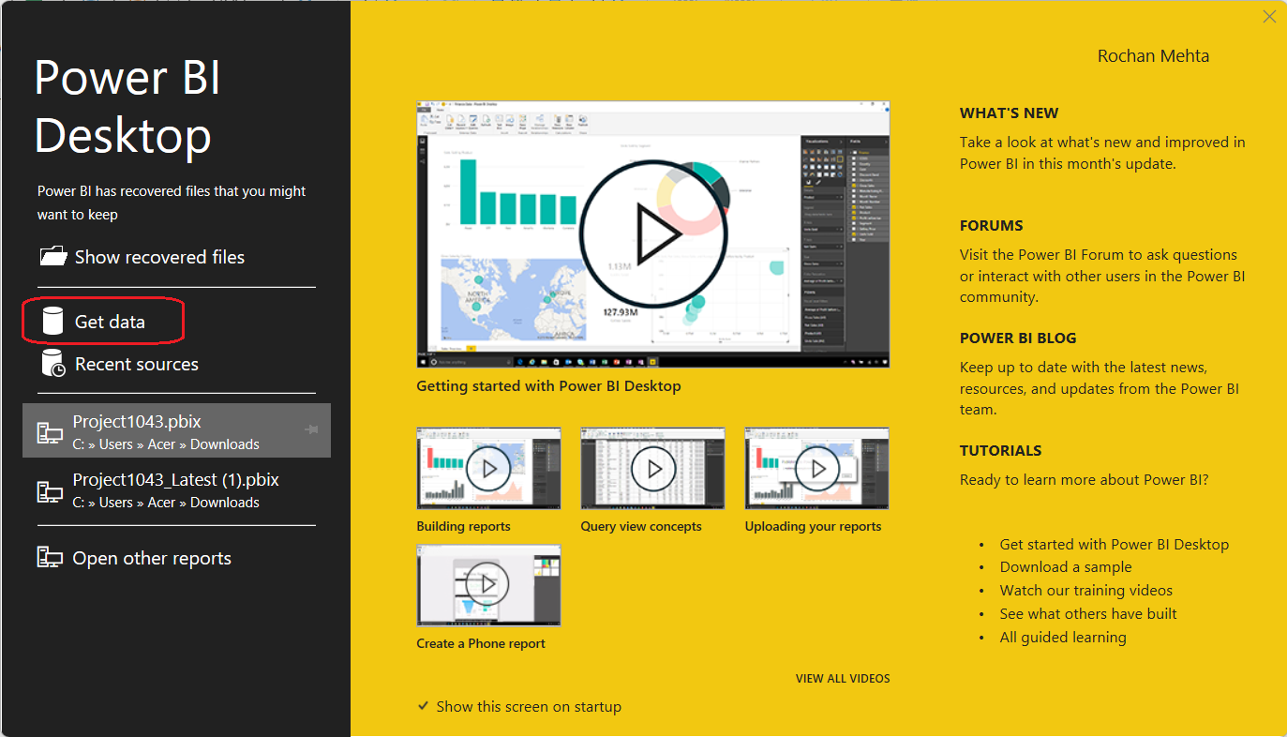

Slide 21
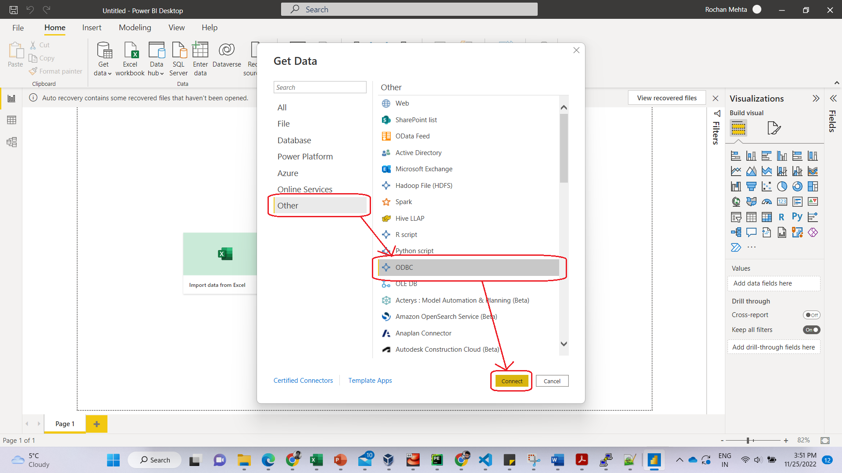

Slide 22
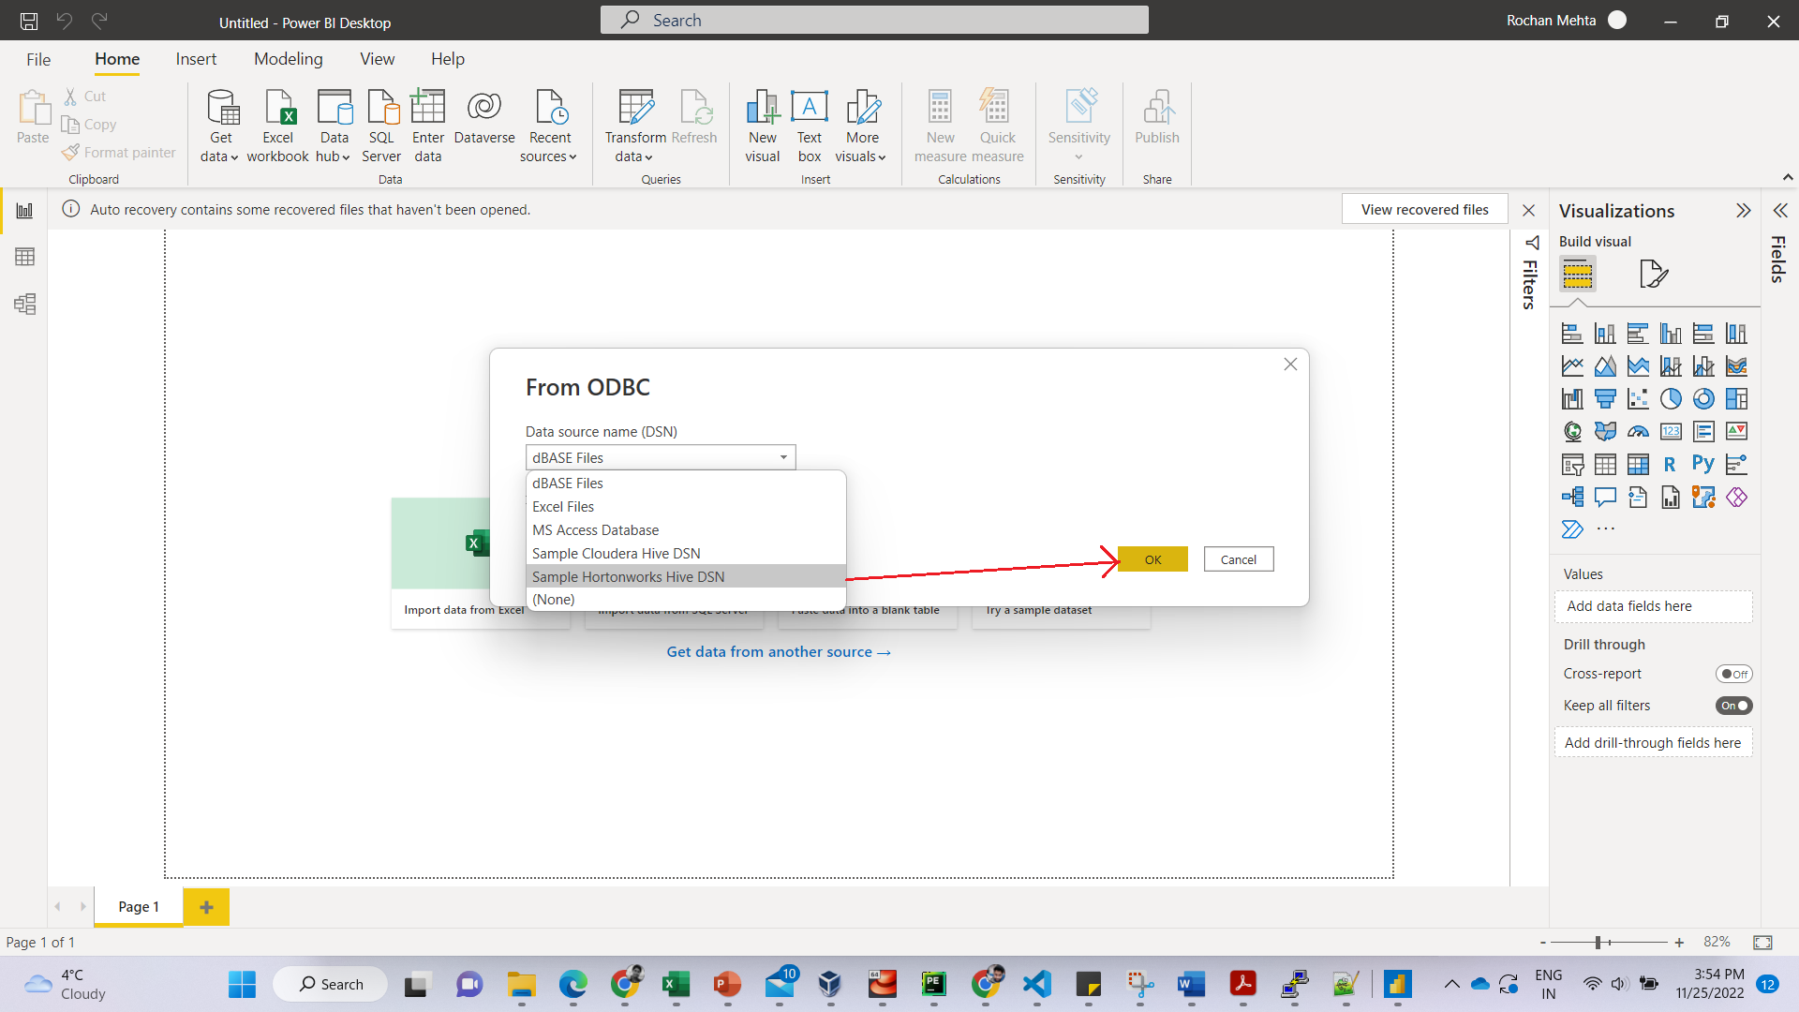

Slide 23
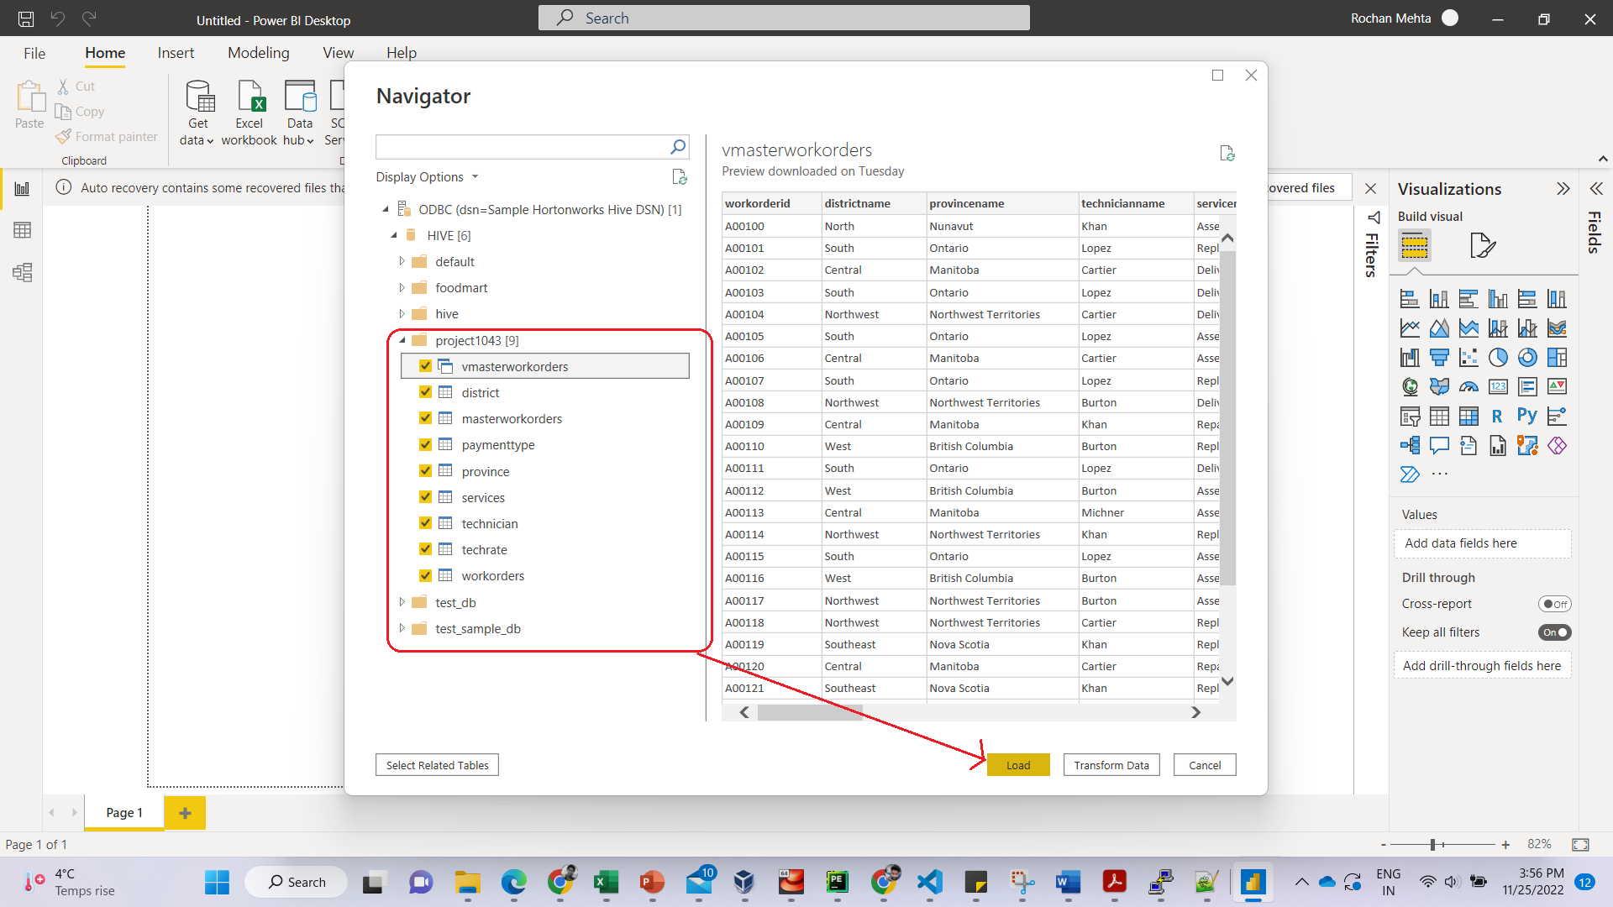

Slide 24
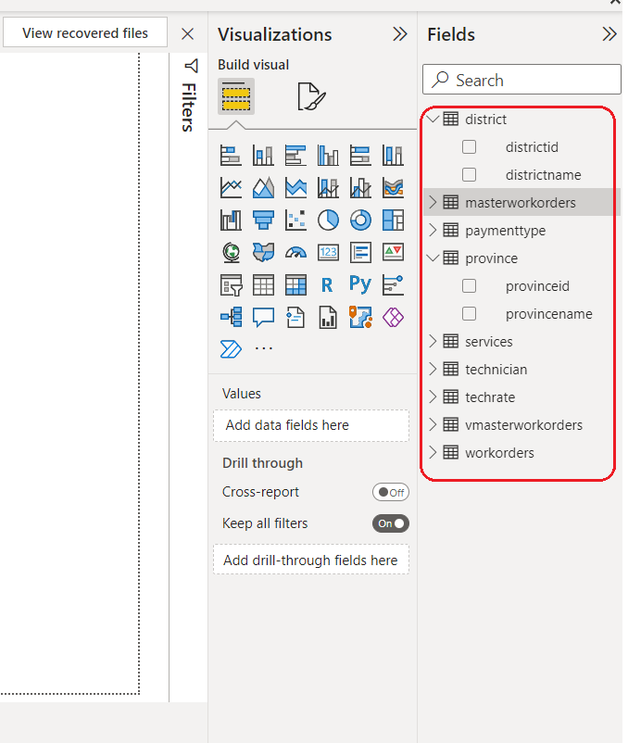
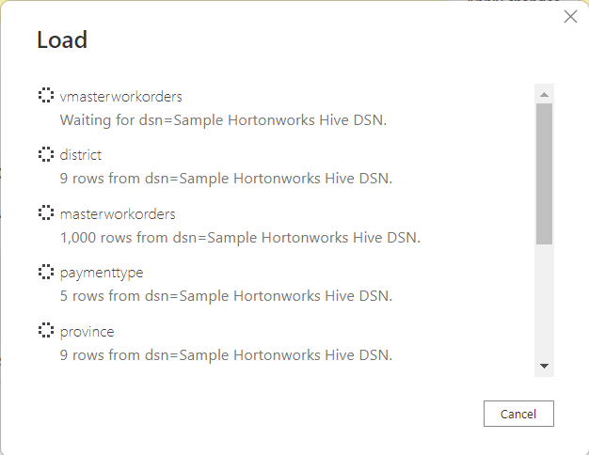

Slide 25
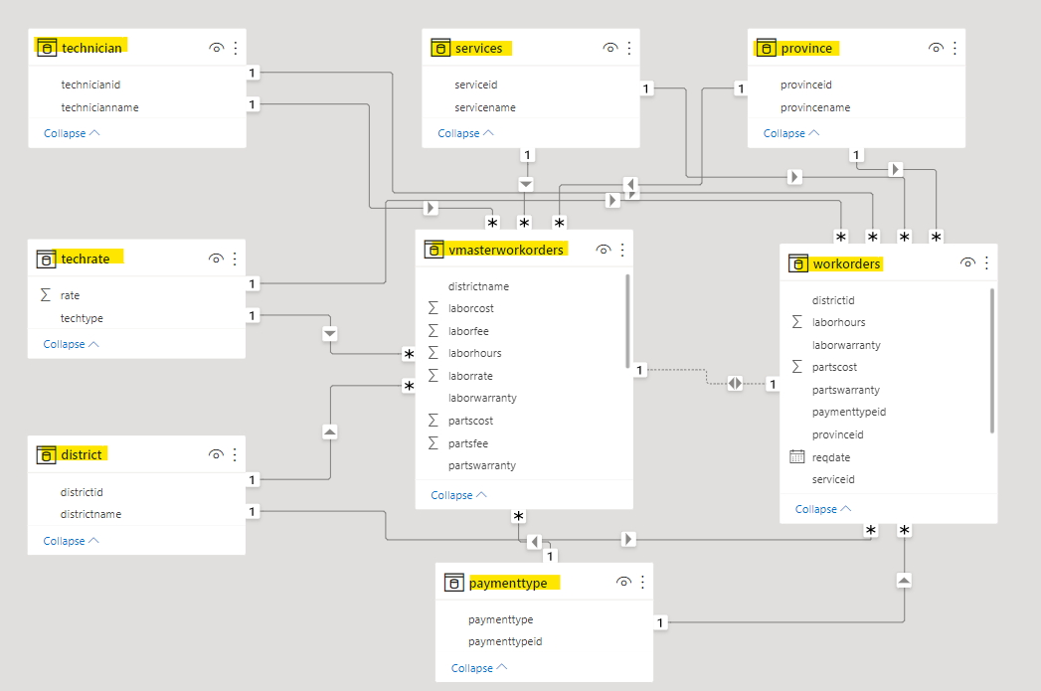
Table Relationships automatically deduced by Power BI
Notes:
<a href="https://storyset.com/education">Education illustrations by Storyset</a>
https://unsplash.com/photos/b6njEJXi9zE

Slide 26
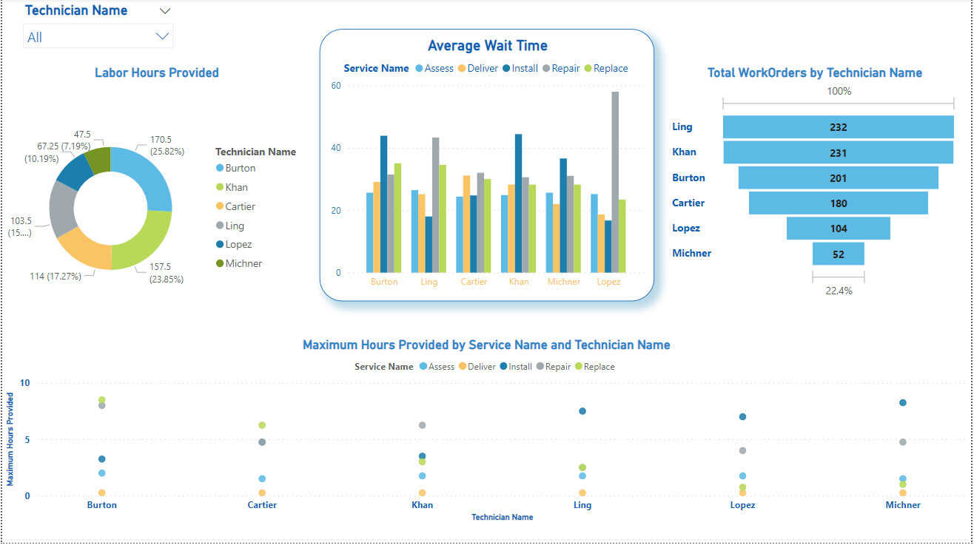
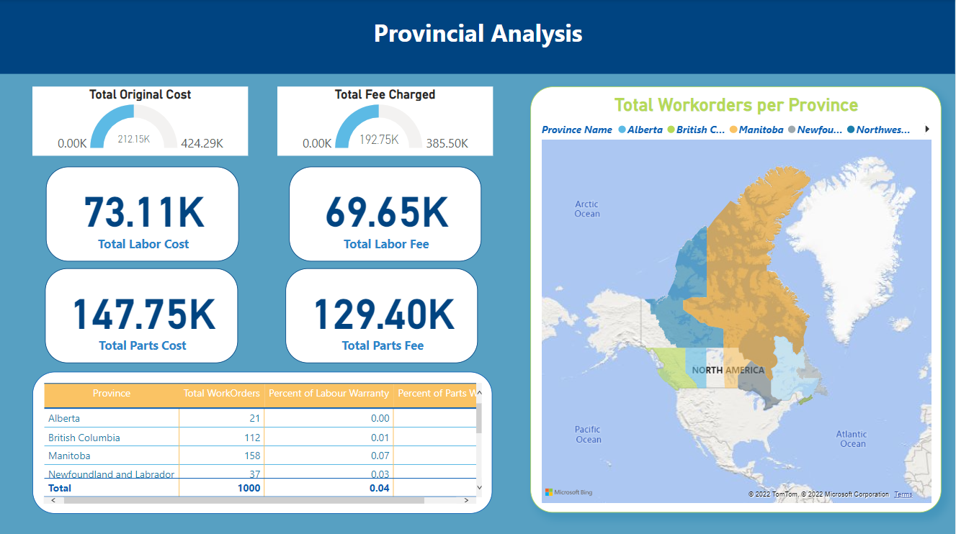
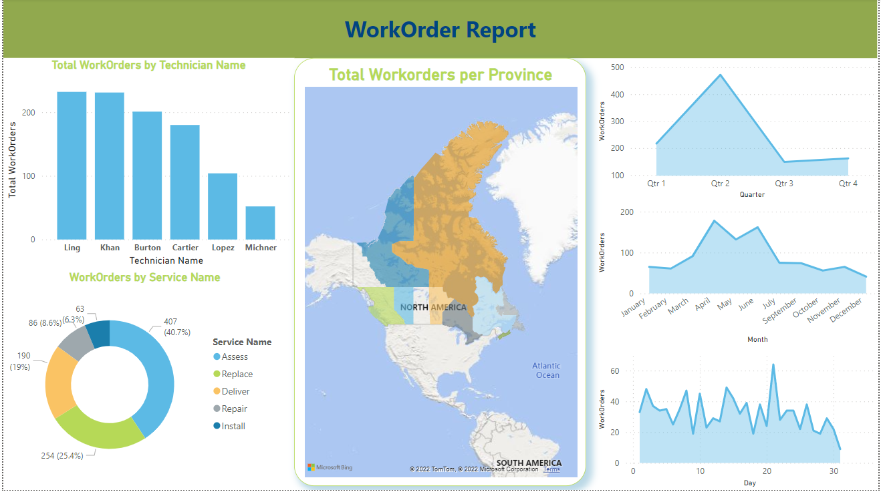
Reports
We have focused our reports on three major categories.
Provincial : This report depicts visualizations focusing on Province based Data.
Technician : This report depicts visualizations focusing on Technicians.
WorkOrders: This report depicts visualizations showing trends based on Work Orders.

Slide 28
Technician Performance Report

Slide 30
Insights from Provincial Report
It shows the total number of workorders each province has received in the given time span
It also shows total cost and total fee contributed by each province along with the figures providing segregated data for labor and parts.
We can also get information like how much percent of the workorders were having parts and labor warranty.
Notes:
<a href="https://storyset.com/education">Education illustrations by Storyset</a>
https://unsplash.com/photos/b6njEJXi9zE

Slide 31
Insights from Technician Report
This is useful to get the insights like how much hours each technician has worked or how many hours each technician has provided in the given time span.
Maximum number of hours given by each technician for all types of services provided by the organization.
Also, what was the average wait time that each technician took to complete a workorder of each service type, This kind of information can the organization to put the right technician according to their capabilities on the right type of service workorders.

Slide 32
Insights from WorkOrder report
With this report, the organization can analyze the workorders they have received in a particular time span. It includes information like how many workorders each technician worked upon.
How many Workorders received each day, month and quarter. This type of information can help analyze that which time of the year was good or bad for the business, so that possible reasons can be found out either to mitigate or use them for our own benefit.
Segregated data as per each service type is also depicted in the report to analyze and understand which type of service is generating how much income (fee) and which one needs improvement.
Notes:
<a href="https://storyset.com/education">Education illustrations by Storyset</a>
https://unsplash.com/photos/b6njEJXi9zE

Slide 33

Important decision-making points

Slide 34

1. Why this data set?
The data set we found had segregated data and had some structure to join the segregated portions together and make sense.
The data set had a lot of different datatypes to work with and make computations with.
Also, it had the potential to create a lot of visualizations and analyze important insights from it.
We wanted to use a layer of RDBMS to simulate a real-life scenario where the organization is operating and all the workorders are getting recorded in an RDBMS database. Now we have to fetch the data to generate Realtime reports to be published. This dataset, like we mentioned earlier, had understandable schema to load it into our RDBMS layer (mysql).
7

Slide 35
2. Use Hive Managed Tables or External Tables?
We wanted our schema and data not to be removed from HDFS even if the tables are dropped in hive. Hence, we decided to use External tables in hive.
3. Create Master Table or Master View?
We used the approach to create a master view in hive instead of another external table because we wanted our data to sync and reflect any new transaction happening in the system. If a static table was used, it would have not reflected any new workorder information. On the other hand, view will capture all the new transactions as well. Since our visualizations are also all based on the master view, our reports will also reflect the new additions.
4. Tableau vs PowerBI?
Tableau is best suited for providing extensive visualizations with large amount of data in very less processing time. Where as PowerBI performs faster where the size of data is limited. The dataset we chose did not had the ability to grow extensively even in a real case scenario. Hence for better performance we chose PowerBI. Also, PowerBI is a cost friendly tool for small enterprises.

Slide 36
REFERENCES
https://www.contextures.com/xlsampledata01.html
https://chen115yaohua.wordpress.com/2017/01/27/microsoft-bi-access-hive-tables-on-hortonworks-sandbox/
Notes:
<a href="https://storyset.com/online">Online illustrations by Storyset</a>

Slide 37

THANK YOU
Notes:
<a href="https://storyset.com/city">City illustrations by Storyset</a>

